Slide 1
Spreadsheets Project: Zomato Restaurants
By:
N. Sai Dhanush

Slide 2
Objective Questions

Slide 3
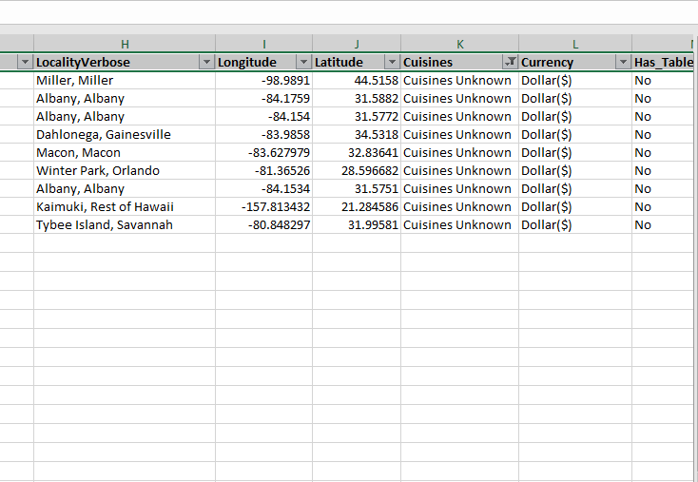
Q1. The data consists of some inconsistent and missing values so ensure that the data used for further analysis is cleaned.
Solution:
In the provided data, there were few missing values in Cuisines Column, about 9 missing values/blanks were found. Instead of removing those rows, blanks were filled using “Cuisines Unknown” values.

Slide 4
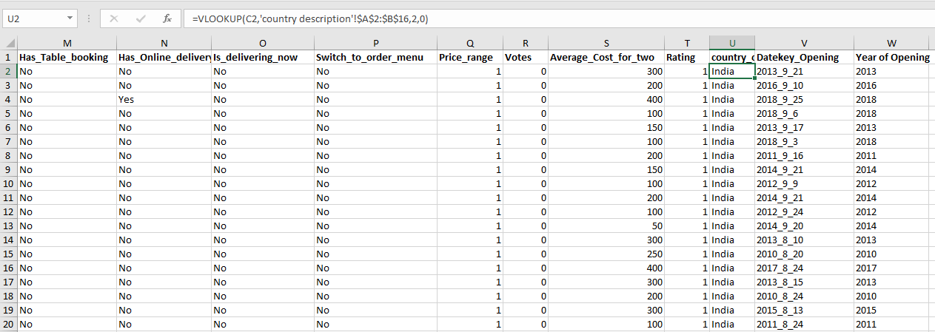
Q2. Using the LookUp functions, fill up the countries in the original data using the Country code.
Solution:
Country names are extracted using VLOOKUP Function. The formula used is mentioned below:
=VLOOKUP(C2,'country description'!$A$2:$B$16,2,0)

Slide 5
Q3. Create a table to represent the number of restaurants opened in each country.
Solution:
This is achieved by incorporating a pivot table, with countries in row labels and count of restaurants in values, which aids in useful analysis.

Slide 6
Q4. Also, the management wants to look at the number of restaurants opened in each year, so provide them with something here.
Solution:
This is achieved by pivot table, with years as row labels and count of restaurants in values.as shown in figure:

Slide 7
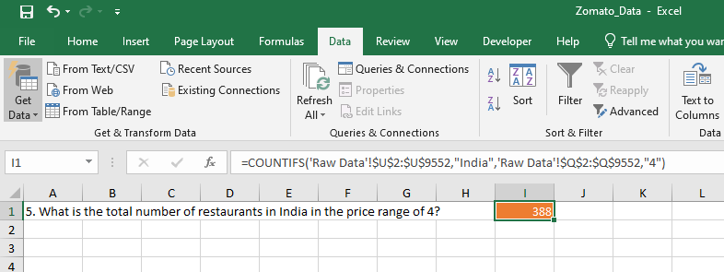
Q5. What is the total number of restaurants in India in the price range of 4?
Solution:
There are 388 restaurants in India with a price range of 4. This value is obtained with the aid of “COUNTIFS” aggregate function.
=COUNTIFS('Raw Data'!$U$2:$U$9552,"India",'Raw Data'!$Q$2:$Q$9552,"4")

Slide 8
Q6. According to the data, what is the average number of voters for the restaurants in each country?
Solution:
The average number of voters in each countries is plotted with the pivot table with countries as row labels and average of voters as values.

Slide 9
Subjective Questions

Slide 10
Q1.Suggest a few countries where the team can open newer restaurants with lesser competition. Which visualization/technique will you use here to justify the suggestions?
Based on the number of restaurants and average ratings for restaurants in countries, I recommend to open newer restaurants. Criteria to decide that is as follows:
Number of existing restaurants < 50.
Average ratings of restaurants < 4.
So, the countries which satisfy these criteria are the one’s where newer restaurants can be recommended:
Australia
Canada
Singapore
Sri Lanka

Slide 11
Q2. Come up with the names of States and cities in the suggested countries suitable for opening restaurants.
Australia
Armidale
Balingup
Dicky Beach
Flaxton
Forrest
Hepburn springs
Inverloch
Lakes Entrance
Lorn
Macedon
Mayfield
Montville
Penola
Phillip Island
Victor Harbor
Canada
Chatam-Kent
Consort
Yorkton
Singapore
Singapore
Sri Lanka
Colombo

Slide 12
Q3. According to the countries you suggested, what is the current quality regarding ratings for restaurants that are open there?
Countries and their quality regarding ratings are listed below:
Country | Average Rating
Australia | 3.66
Canada | 3.58
Singapore | 3.58
Sri Lanka | 3.87

Slide 13
4. Also, what is the current expenditure on food in the suggested countries, so we can keep our financial expenditure in control?
Since, we have limited data to have a note on expenditure on the food, I am utilizing average cost for two people as a metric to answer this question and it is shown below:
Country | Average Expenditure
Australia | 24.08
Canada | 36.25
Singapore | 155.75
Sri Lanka | 2375

Slide 14
Q5. Come up with the names of restaurants from the recommended states that are our biggest competitors and also those that are rated in the lower brackets, i.e. 1-2 or 2-3.
Here are few restaurants in the suggested countries:
Australia
Pier 70
Poets Café
Star Buffet
Singapore
Makansutra Glutans Bay
Canada
Consort Restaurant
Sri Lanka
Elite Indian Restaurant
Queen’s cafe

Slide 15
Q6. Which cuisines should we focus on in the newer restaurants to get better feedback? Does the of cuisines affect the restaurant ratings?
Based on the Observation from the Pivot table, restaurants with higher ratings have a wide variety of cuisines ie: not specific to the regional cuisines but also foreign cuisines.
Specifically it is difficult to recommend a cuisine for each restaurant., so introducing foreign cuisines besides Regional cuisines will always pave for better feedback and ratings.

Slide 16
Q7. According to our current data, should we go for online delivery and table booking? Does that affect the customer’s ratings?
Based on Observation, Currently very fewer have the feasibility for Online Delivery and Table booking – from which we can infer that it might affect feedback and rating.
So, It is highly recommendable to have both Online delivery and Table booking

Slide 17
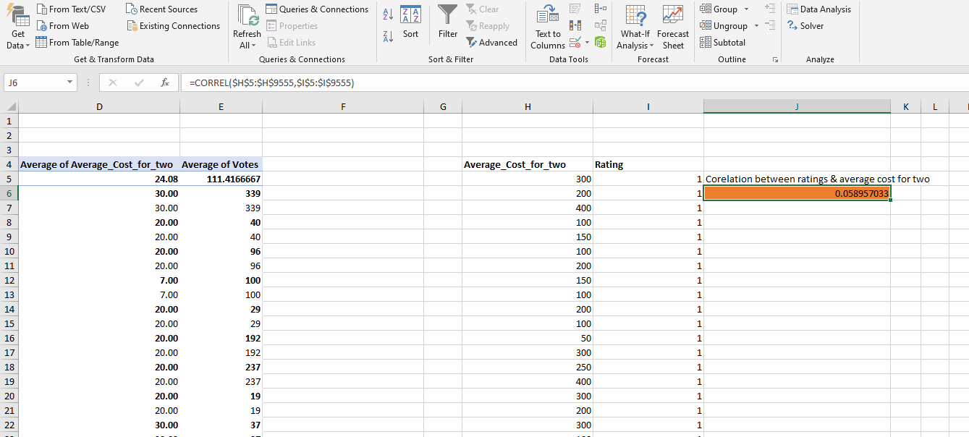
Q8. Should the team keep the rate of cuisines higher? Will that affect the feedback? According to our data are the rates of cuisines and ratings, correlated?
Solution:
Co-relation between rate of cuisines (Average cost for two) and ratings is 0.0589
Which means rates of cuisines and ratings are not co-related, value near to zero indicates neutrally corelated.
So, it is better to decide the rates of cuisines on other factors., like: Types of Cuisines, Ambience..etc

Slide 18
Thank You

